Slide 1

Using Power BI with Dynamics CRM Online
DYNAMICS CRM 2016

Slide 2

Mitch Milam
Dynamics CRM Architect
Independent consultant and trainer
Ten-Time Dynamics CRM MVP
mitch@xrmcoaches.com
infinite–x.net
@mitchmilam
http://tinyurl.com/MitchMilamLinkedIn

Slide 3
Future Events
July webinars will be announced soon

Slide 4
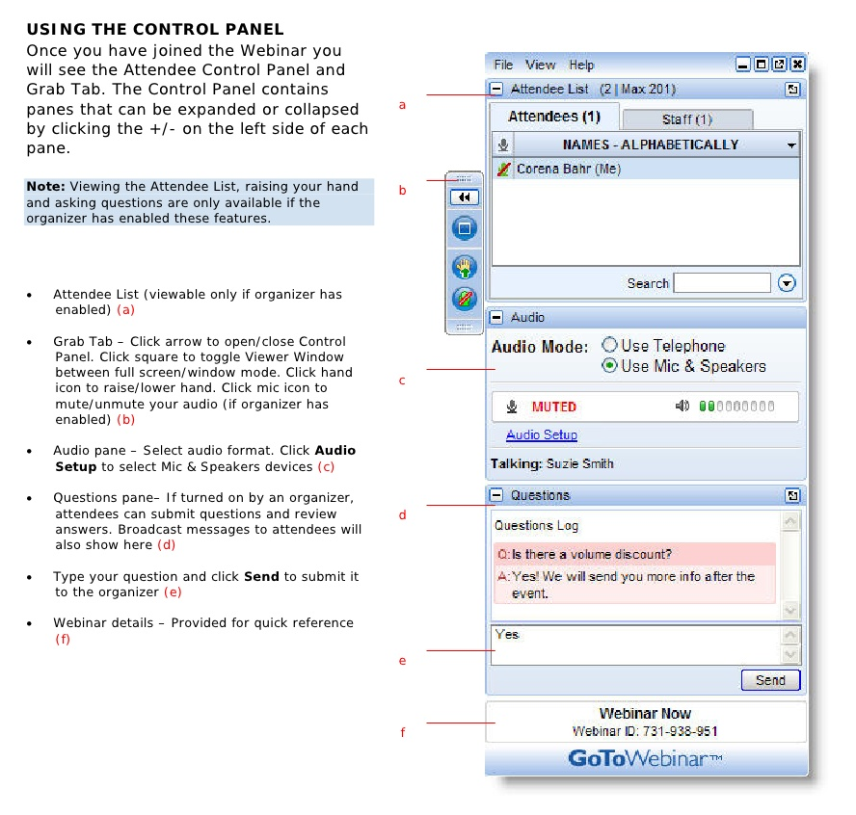
Webinar Housekeeping

Slide 5



2016 Training Roadmap
Webinars
http://www.xrmcoaches.com/webinars
KnowledgeBits
http://www.xrmcoaches.com/knowledgebits
Learning Plans
http://www.xrmcoaches.com/freestuff
More Goodies
Practice tests
On–Demand video training
Instructor–led training
Books

Slide 6
Agenda
Overview
Demonstration

Slide 7
Overview

Slide 8
What Power BI Is
An extension of, not replacement for, SQL Server Reporting Services (SSRS)
Built for large data sets

Slide 9
What Power BI Is Not
Transactional system

Slide 10
Features and Notes
Does not have granular security like CRM does
No drill through to CRM data (coming soon)

Slide 11
Power BI Web
Main Functionality
Build models
Create visuals
Updated weekly

Slide 12
Power BI Desktop
Main Functionality
Create Visuals
Sharing
Updated monthly

Slide 13
Power BI Pro
Feature | Standard | Pro
Data capacity | 1GB | 10GB
Pricing | Free | $9.99 per user, per month
Consume content that is scheduled to refresh | Daily | Hourly
Consume streaming data in your dashboards and reports | 10K rows/hour | 1M rows/hour
Consume live data sources with full interactivity |  | •
Access on-premises data using the Data Connectivity Gateways (Personal and Data Management) |  | •
Collaborate with your team using Office 365 Groups in Power BI |  | •
Create, publish and view organizational content packs |  | •
Manage access control and sharing through Active Directory groups |  | •
Shared data queries through the Data Catalog |  | •

Slide 14
Getting Started

Slide 15
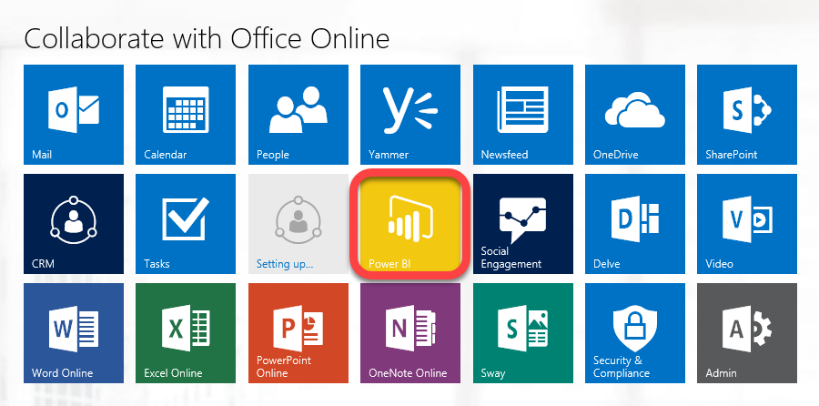
Starting Power BI

Slide 16
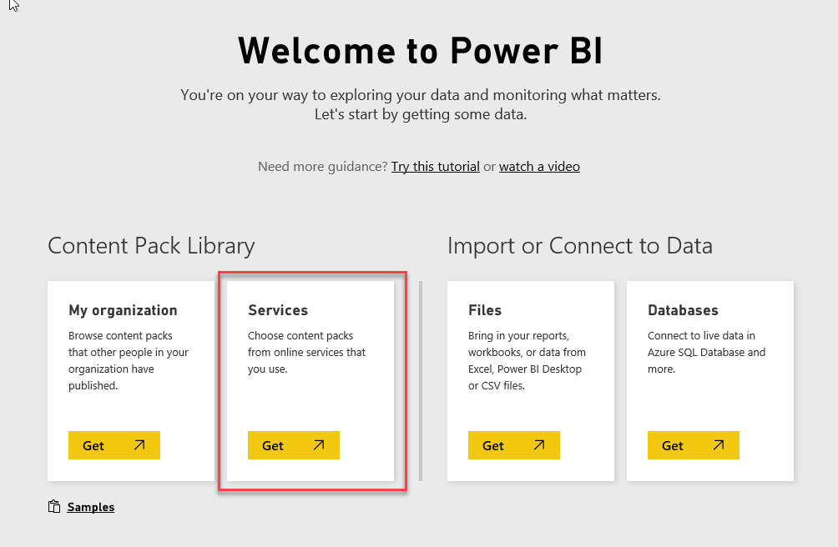
Select Your Data Source

Slide 17
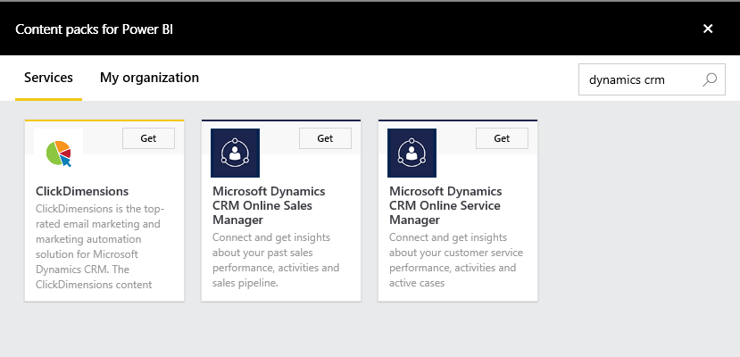
Available Content Packs

Slide 18
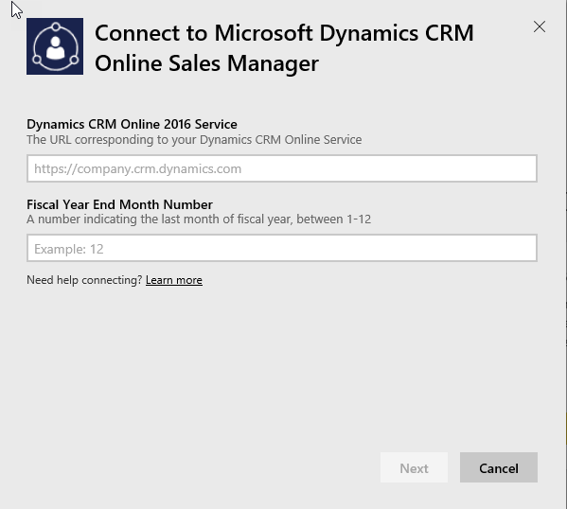
Connecting to Dynamics CRM Online

Slide 19
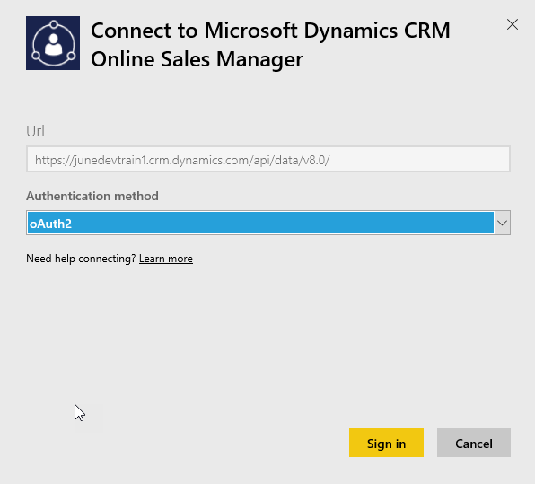
Connection Information

Slide 20
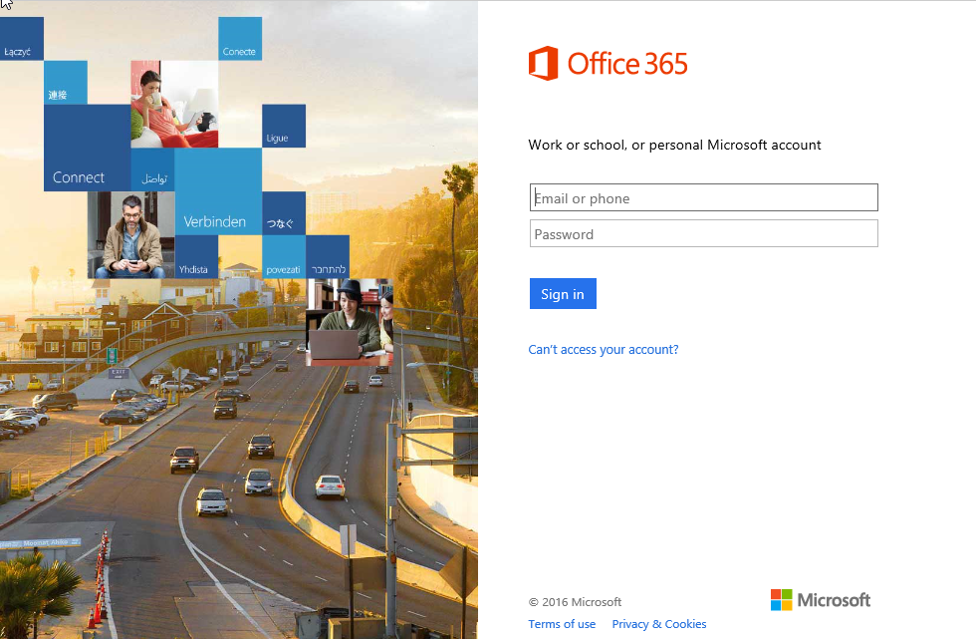
Authentication

Slide 21
Dashboards

Slide 22
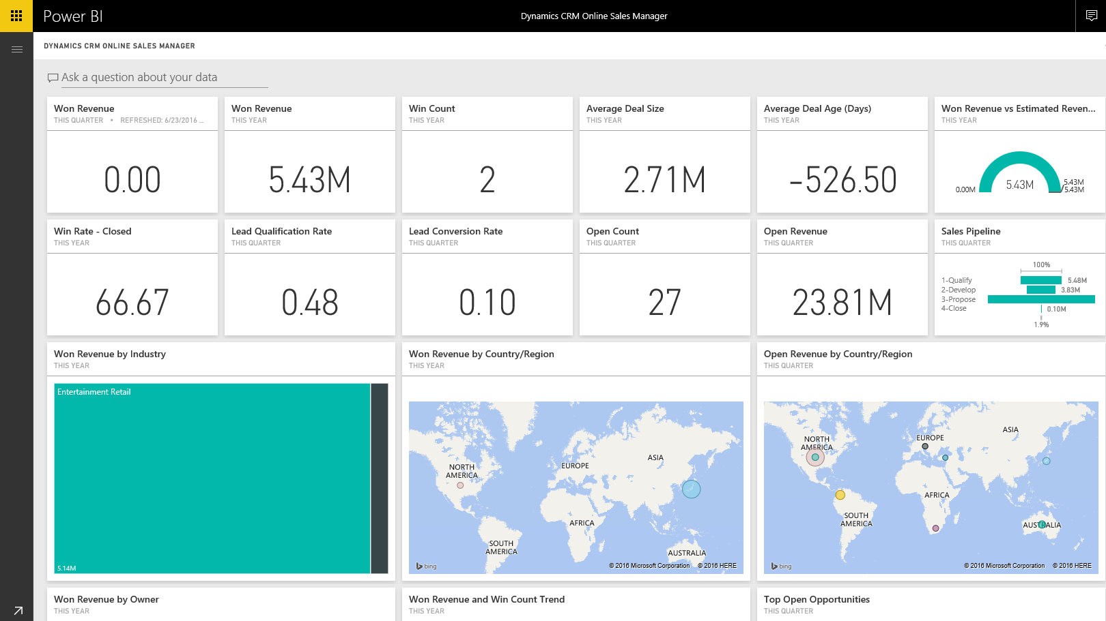
Sales Manager Dashboard

Slide 23
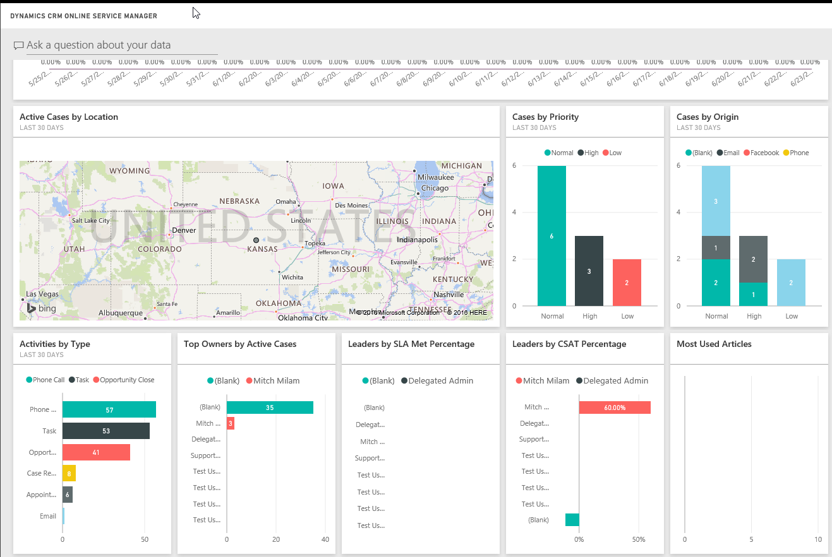
Service Manager Dashboard

Slide 24
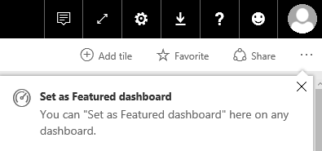
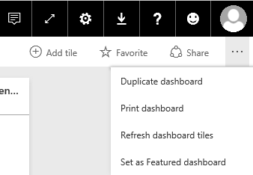
Set as Featured Dashboard

Slide 25
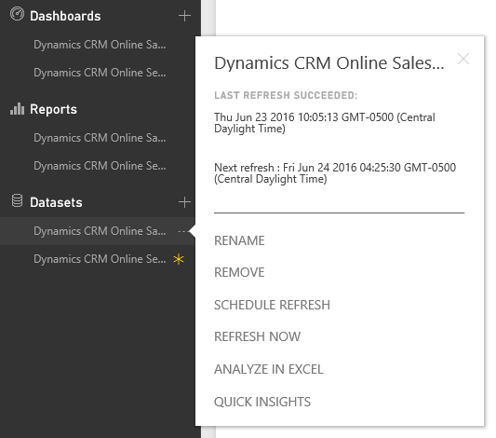
Dataset Operations

Slide 26
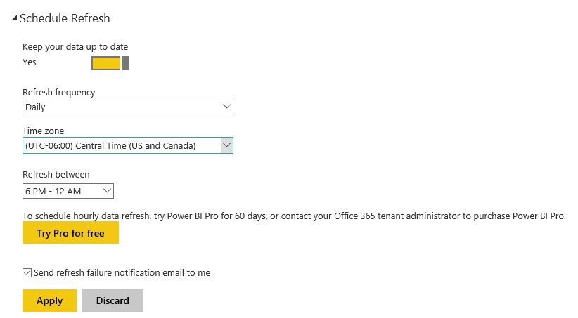
Scheduled Data Refresh

Slide 27
Power BI Desktop

Slide 28
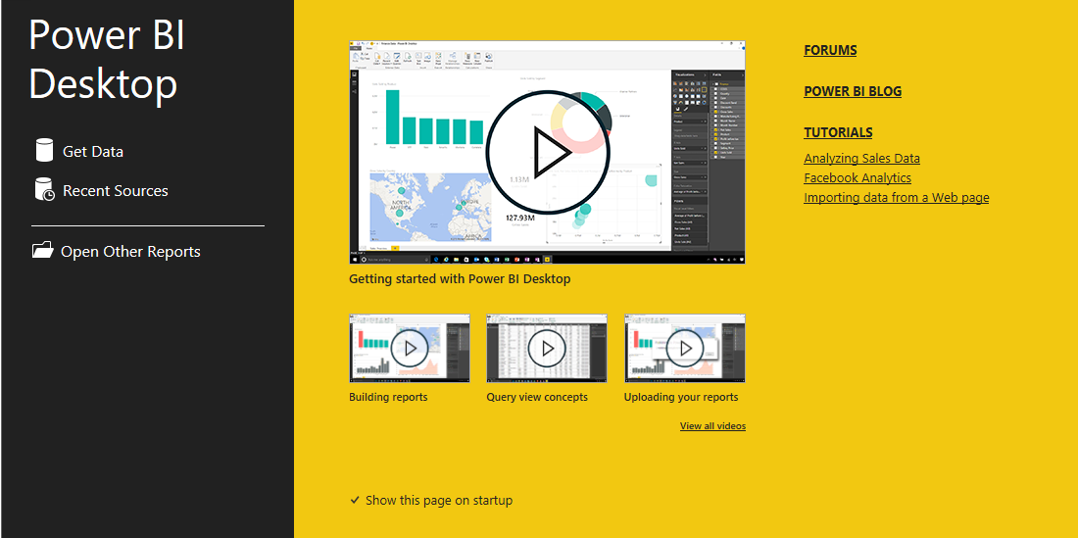
Startup Screen

Slide 29
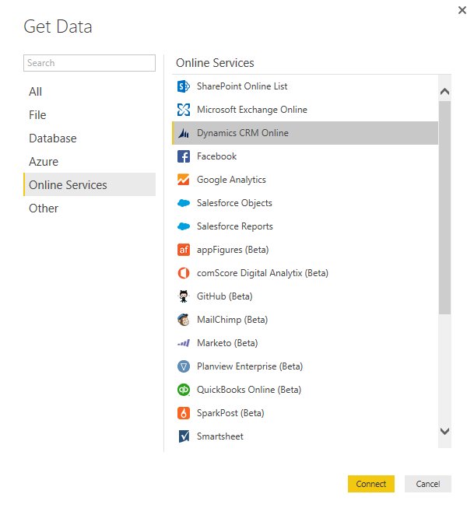
Connect to Dynamics CRM

Slide 30
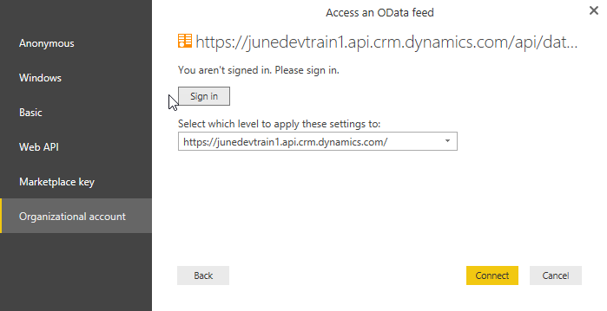
Enter Your Credentials

Slide 31
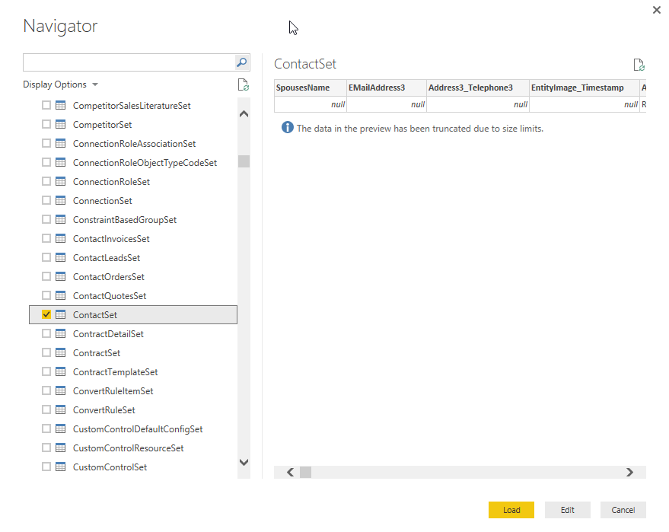
Select Your Datasets

Slide 32
Power BI Inside of
Dynamics CRM

Slide 33
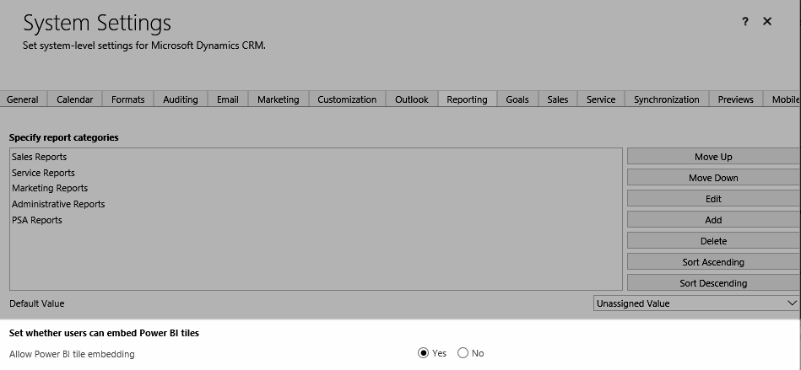
Embed Power BI Tiles

Slide 34
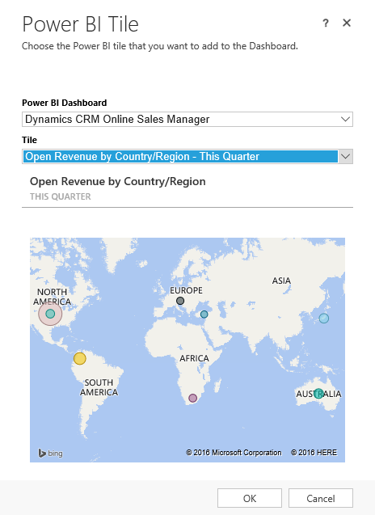

Adding Power BI Tiles

Slide 35
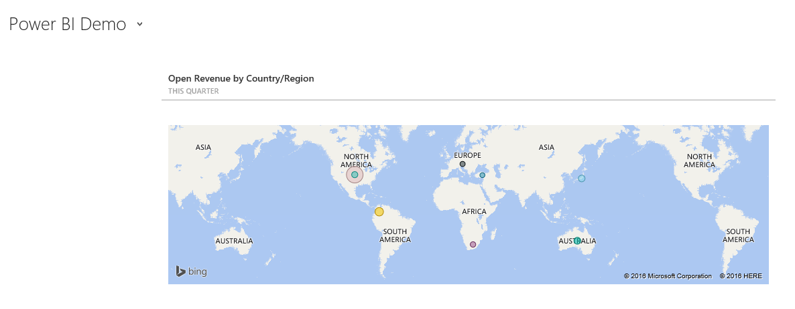

Power BI Tile in Actions

Slide 36
Tips

Slide 37
Internet Searches
Use a date filter when searching for information
Power BI is changing so fast that much of the information is out of date
Information older than 12 months may not be relevant

Slide 38

Follow Scott Sewell
Dynamics CRM MVP
Budding Power BI Guru
Works for Hitachi Solutions
All around nice guy
@scottsewell

Slide 39
Demonstration

Slide 40
Questions?

Slide 41
Thank You

